Slide 1
Data Link Layer Protocols

Slide 2
Flow Control
Ensuring the sending entity does not overwhelm the receiving entity
Preventing buffer overflow
Transmission time
Time taken to emit all bits into medium
Propagation time
Time for a bit to traverse the link

Slide 3
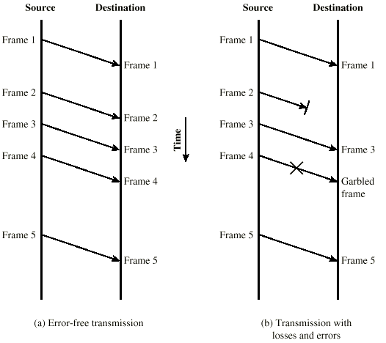
Model of Frame Transmission

Slide 4
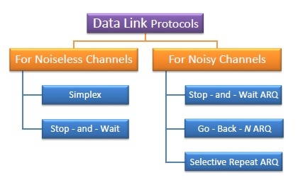

Data link protocols can be broadly divided into two categories, depending on whether the transmission channel is noiseless or noisy.

Slide 5
Initial Assumptions
Simplex Channel
Infinite buffer capacity with the receiver
Error free transmission
Network layer at the senders end is always ready with data
No need for flow control

Slide 6


Unrestricted Simplex Protocol – the Utopia
Both the transmitting and receiving network layers are always ready
Framing only
No error or flow control
Infinite buffer space is available
The communication channel between the data link layers never damages or loses frames
Data are transmitted in one direction only
Processing time can be ignored

Slide 7





Unrestricted Simplex Protocol
void sender1 (void)
{
frame s;
packet buffer;
while (true) {
from_network_layer(&buffer);
s.info = buffer;
to_physical_layer(&s);
}
}

Slide 8

void receiver1 (void)
{
frame r;
event_type event;
while (true) {
wait_for_event(&event);
from_physical_layer(&r);
to_network_layer(&r.info);
}
}

Slide 9


Simplex Protocol
The Simplex protocol is hypothetical protocol designed for unidirectional data transmission over an ideal channel, i.e. a channel through which transmission can never go wrong.
It has distinct procedures for sender and receiver.
The sender simply sends all its data available onto the channel as soon as they are available its buffer.
The receiver is assumed to process all incoming data instantly.
It is hypothetical since it does not handle flow control or error control.

Slide 10


Simplex Stop-and-Wait Protocol
Assumptions
Finite buffer
The communication channel between the data link layers never damages or loses frames
Data are transmitted in one direction only
Processing time can be ignored

Slide 11
Stop and Wait
Send one packet & Wait for Ack before proceeding
Source transmits frame
Destination receives frame and replies with acknowledgement
Source waits for ACK before sending next frame
Destination can stop flow by not send ACK
Works well for a few large frames

Slide 12
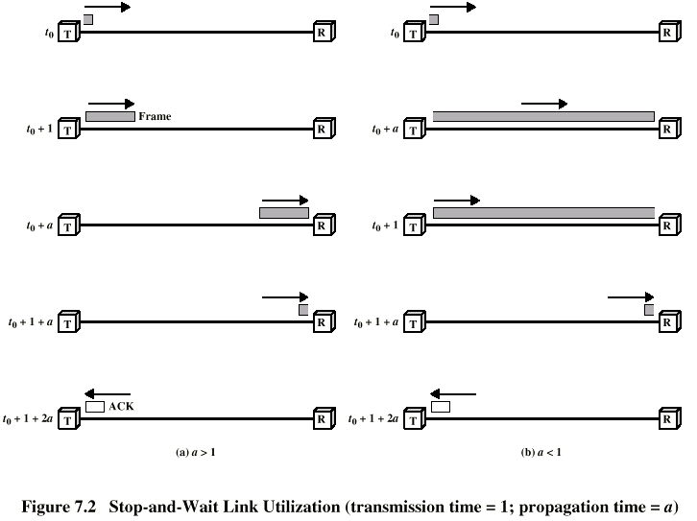
Stop and Wait Link Utilization

Slide 13
Simplex Stop-and-Wait Protocol
void sender2 (void)
{
frame s;
packet buffer;
event_type event;
while (true) {
from_network_layer(&buffer);
s.info = buffer;
to_physical_layer(&s);
wait_for_event(&event);
}
}

Slide 14
void receiver2 (void)
{
frame r, s;
event_type event;
while (true) {
wait_for_event(&event);
from_physical_layer(&r);
to_network_layer(&r.info);
to_physical_layer(&s);
}
}

Slide 15


Stop – and – Wait Protocol
Stop – and – Wait protocol is for noiseless channel.
It provides unidirectional data transmission without any error control facilities.
However, it provides for flow control so that a fast sender does not drown a slow receiver.
The receiver has a finite buffer size with finite processing speed.
The sender can send a frame only when it has received indication from the receiver that it is available for further data processing.

Slide 16

A Simplex Protocol for a Noisy channel
Assumptions
Finite Buffer
A positive acknowledgement with retransmission protocol.
Data are transmitted in one direction only
Processing time can be ignored

Slide 17


Automatic Repeat request (ARQ) protocols
Positive Ack
1-bit sequence number in frames (not in acks)
Timeout to detect lost frames/acks
Retransmission
Can fail under early timeout conditions
Full Duplex Communication
Piggybacking of acks
Temporarily delaying outgoing acknowledgements so that they can be hooked onto the next outgoing data frame

Slide 18

Stop – and – Wait ARQ
Stop – and – wait Automatic Repeat Request (Stop – and – Wait ARQ) is a variation of the Stop –and- wait protocol with added error control mechanisms, appropriate for noisy channels.
The sender keeps a copy of the sent frame.
It then waits for a finite time to receive a positive acknowledgement from receiver.
If the timer expires or a negative acknowledgement is received, the frame is retransmitted.
If a positive acknowledgement is received then the next frame is sent.

Slide 19

Fragmentation
Large block of data may be split into small frames
Limited buffer size
Errors detected sooner (when whole frame received)
On error, retransmission of smaller frames is needed
Prevents one station occupying medium for long periods
Stop and wait becomes inadequate

Slide 20
Sliding Windows Flow Control
Allow multiple frames to be in transit
Receiver has buffer W long
Transmitter can send up to W frames without ACK
Each frame is numbered
ACK includes number of next frame expected
Sequence number bounded by size of field (k)
Frames are numbered modulo 2^{k}

Slide 21


Sliding Window Protocols
Window = Set of sequence numbers to send/receive
Sender window
Sender window increases when ack received
Packets in sender window must be buffered at source
Sender window may grow in some protocols
Receiver window
Packets outside window discarded
Window advances when sequence number = low edge of window received
Receiver window always constant
Sender transmits W frames before blocking (pipelining)

Slide 23
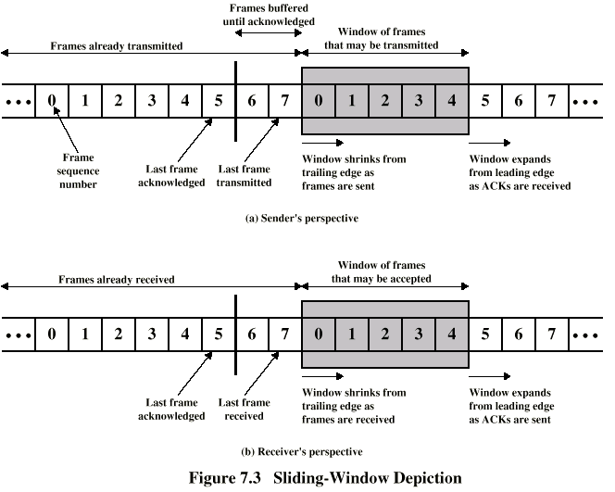


Sliding Window Diagram

Slide 24
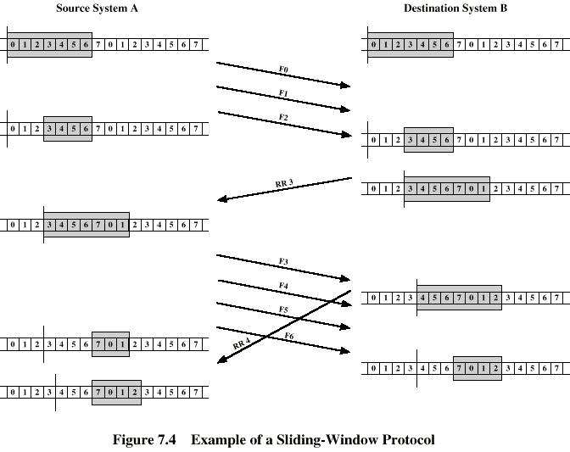
Example Sliding Window

Slide 25

Sliding Window Protocols
A One-Bit Sliding Window Protocol
A Protocol Using Go Back N
A Protocol Using Selective Repeat

Slide 26

One-Bit Sliding Window
Stop and Wait + error control
Piggybacked acks
Acks sent instantly
Packets may be resent to accommodate immediate piggybacking
Acks contain sequence number
Peculiar case: when both sides start simultaneously

Slide 27
Two scenarios for protocol 4. (a) Normal case.
(b) Abnormal case.
The notation is (seq, ack, packet number). An asterisk indicates where a network layer accepts a packet.

Slide 28
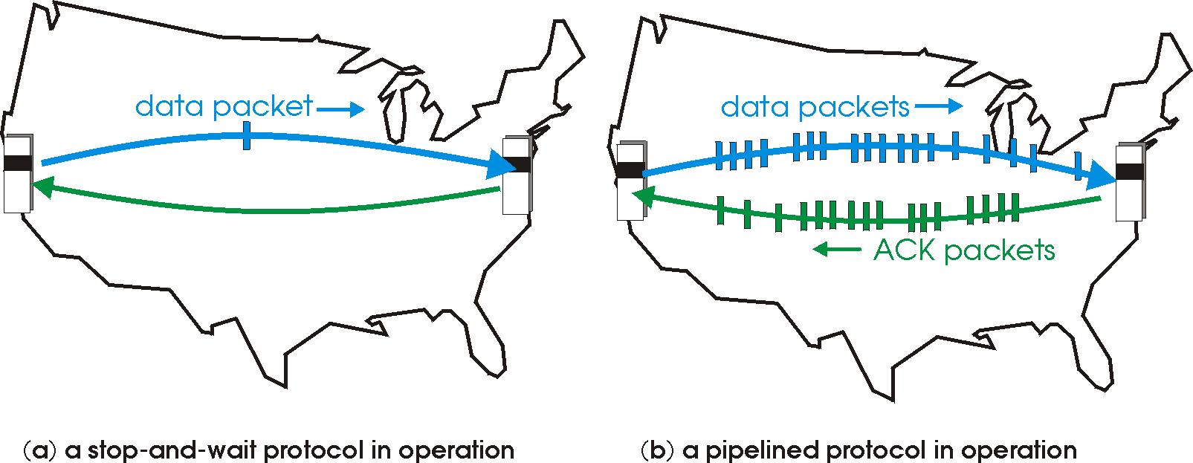


Sliding Window Protocol(Duplex)
At any instant of time, the sender & receiver maintain a set of sequence numbers corresponding to frames it is permitted to send/receive
Piggybacking
Pipelining

Slide 29
Pipelining and error recovery. Effect of an error when
(a) receiver’s window size is 1 and (b) receiver’s window size is large.

Slide 30



Go – Back – N ARQ
Go – Back – N ARQ provides for sending multiple frames before receiving the acknowledgement for the first frame.
It uses the concept of sliding window, and so is also called sliding window protocol.
The frames are sequentially numbered and a finite number of frames are sent.
If the acknowledgement of a frame is not received within the time period, all frames starting from that frame are retransmitted.

Slide 31
Round trip propagation + transmission time not negligible, Stop and Wait is not efficient
Sender is allowed to transmit multiple packets without waiting for an acknowledgement, but is constrained to have no more than some maximum allowable number (N)
Use cumulative acknowledgement
Ack the latest packet (N) if all packets (< N) are received.
Discard out-of-order packets, no receiver buffering
Sliding Window + Retransmit all packets starting from earliest unacked packet
Can waste a lot of bandwidth if error rate high

Slide 32


Selective Repeat ARQ
This protocol also provides for sending multiple frames before receiving the acknowledgement for the first frame.
However, here only the erroneous or lost frames are retransmitted, while the good frames are received and buffered.

Slide 33
Selective Repeat
Sliding Window + Retransmit just the bad frame when Nak received
Out-of-order buffering required at destination
Loses time (and hence throughput) if bursty loss of frames
Acks not cumulative.
Non-sequential arrival of packets
ensure no overlap with old window when receiver advances window
Maximum Window = (Sequence Number Space)/2

Slide 34
Out-of-order buffering not mandatory at destination
Maximum Window = Sequence Number Space - 1
N timers or 1 timer may be used
Simulation of multiple timers in software. (a) The queued timeouts.
(b) The situation after the first timeout has expired.

Slide 35
Enhancement to piggybacking
Auxiliary Ack timer
Set timer when packet to be acked is received
If no reverse data, generate Ack when timer goes off
Send negative ack (Nak) when out-of-order frame received
Source retransmits Nak’ed frame
Naks not cumulative
Do not send duplicate Nak

Slide 36

Sliding Window Enhancements
Receiver can acknowledge frames without permitting further transmission (Receive Not Ready)
Must send a normal acknowledge to resume
If duplex, use piggybacking
If no data to send, use acknowledgement frame
If data but no acknowledgement to send, send last acknowledgement number again, or have ACK valid flag (TCP)

